Slide 1
CI/CD with GIT
14-Apr-2022
Pushkar Kalantri

Slide 2
Software Integration

Slide 3
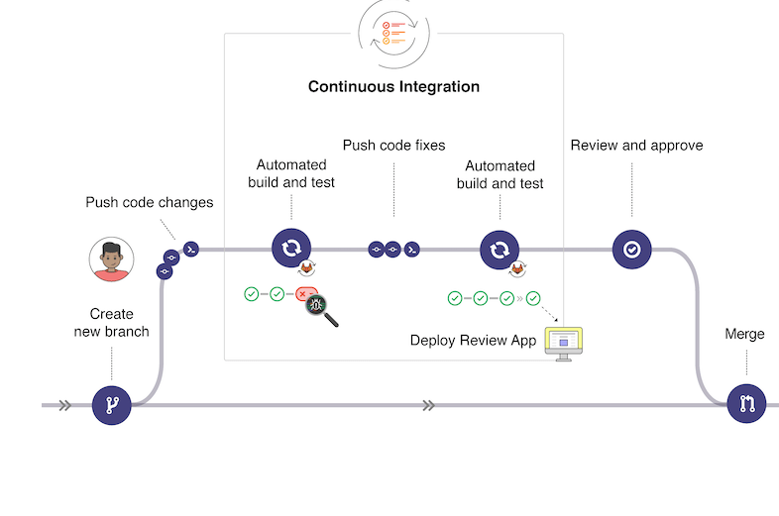
Software part integration (Bsw, EMF, RTE, MCAL ..)
Overall, SW Integration

Slide 4
Steps During Continuous integration
Developer will work on branch created for the module.
After development work, Developer will push the changes on GIT.
On Git automatic build, QAC and polyspace will triggered
If any fixes required, developer push corrections on git on respective module branch.
After the build, QAC and polyspace reports are clear on module branch, then merge request will be raised to development branch and assign to module owner.
Module owner will perform the review.
After the review and review process code will be Merged on development branch.

Slide 5
Pre-requisite
Dedicated katapault server for ZF project
Need to have dedicated system to run QAC and polyspace.
Need to get support from katapault service team for QAC server installation as well as polyspace installation.
Project compiler needs to be installed on provided dedicated system.

Slide 6



Build & test
Merge
Sub-branch
Build & Test Results
Katapult
Unit-Test & Static Analysis
Dev. Fetch / Pull
Auto Build
Build
C4K Base Environment
Development
Base Project Repo
Repo. Analysis
Dev. Updates
Development Team
SubBranch
HIL/ V&V
ZF Repo/FTP
App_Branch
SubBranch
CDD_Branch
Req based Testing
SubBranch
BSW_Branch
ZF App Library
Integration Team
Fetch/Pull
Fetch/Pull
Fetch/Pull
Sub-Branch
Final Integration Testing
Integration_Branch
Interface Analysis
Deliverables to ZF
BSW/Cdd/App Integration

Slide 7
Module Branches
Currently Below branches are created for CI purpose
CDD
RTE
MCAL
BSW_Module

Slide 8
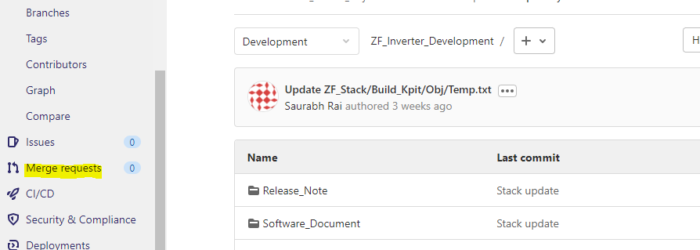
Steps To be followed for Continuous Integration
Rise a merge request on self from Development to respective module branch. For this please follow below step
Go to the respective branch. Click on Merge request option, show in yellow highlight in below snap

Slide 9
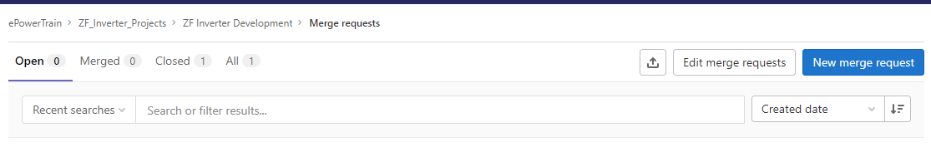
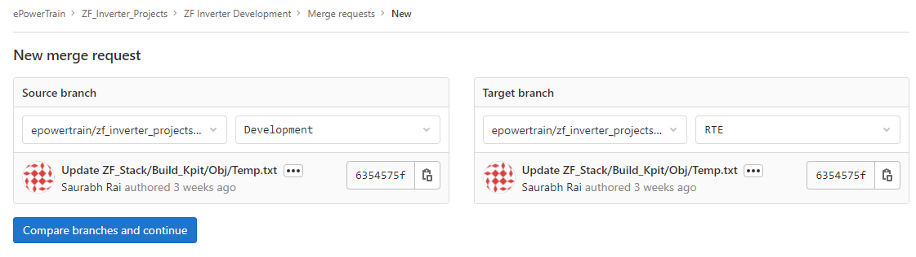
Click on new merge request
Then select the source and destination branch. Before start of work, working branch must be sync with development. So First we will select “Development” as our source branch and “<module_branch>” as a destination branch

Slide 10
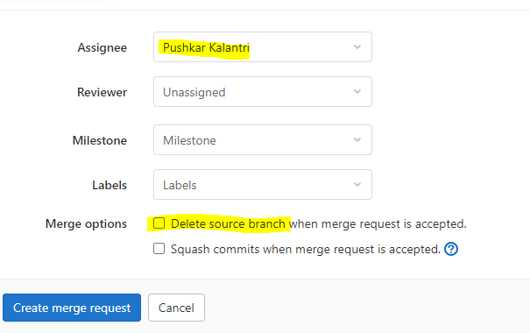
After clicking on “Compare and continue” select the assignee. Make sure both check box is un-tick

Slide 11
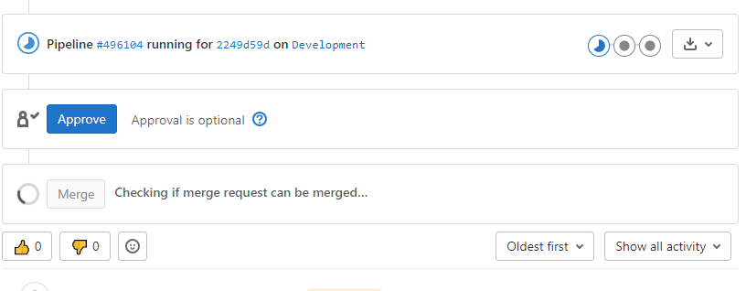
Marge the Development branch code to the respective module branch by opening the merge request

Slide 12
After merging Development branch to module branch, module developer will do development.
After completing the development and unit testing, Module developer will rise the merge request to development branch and assign this merge request to module owner.
Module Owner will perform the review and Approve the merge request so that it will be merged on Development branch

Slide 13
RTE Integration

Slide 14
ASW-Integration Steps
Analysis and Validation of ARXML and source code.
Creation or updating of Service component.
RTE configuration and Mapping.
Com Isignal mapping.
RTE Generation.
A2l Creation.
ASW & BSW compilation and testing.
Update test report.

Slide 15
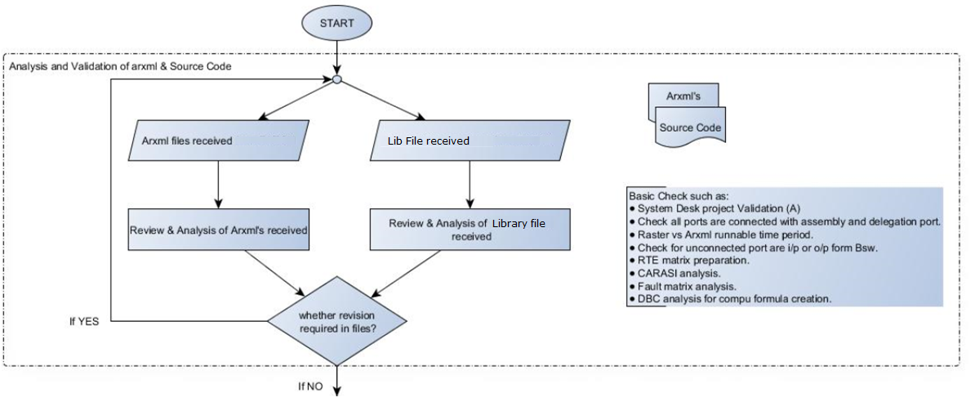
ASW-Integration Steps -1 macro details
(A) – Automatic execution

Slide 16
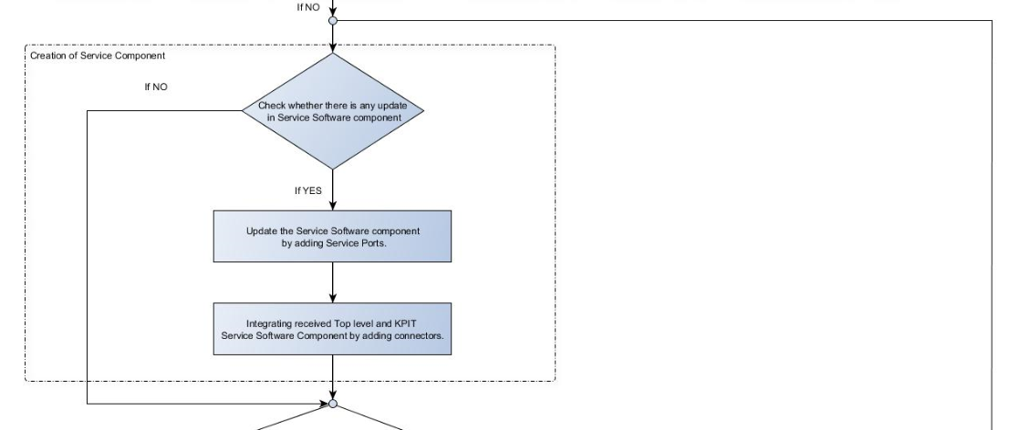
ASW-Integration Steps -2 macro details
Service components are like DEM_swc. In this we configure server port of the Set_EventStatus

Slide 17
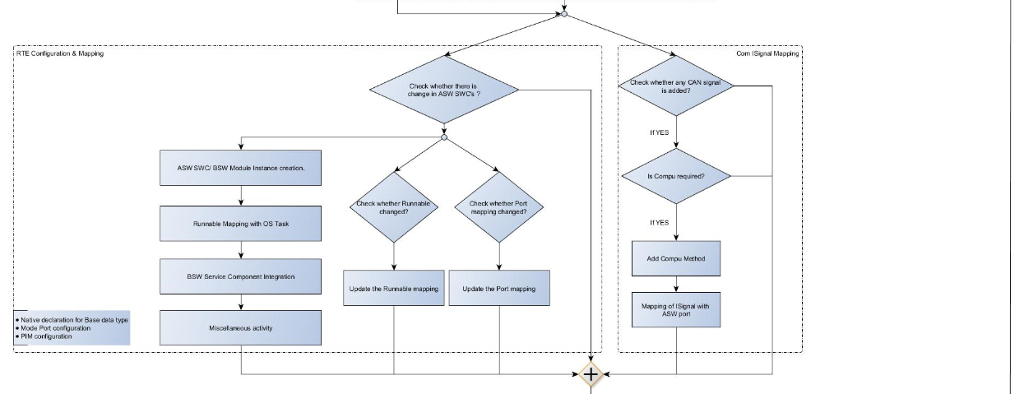
ASW-Integration Steps -3 & 4 macro details

Slide 18
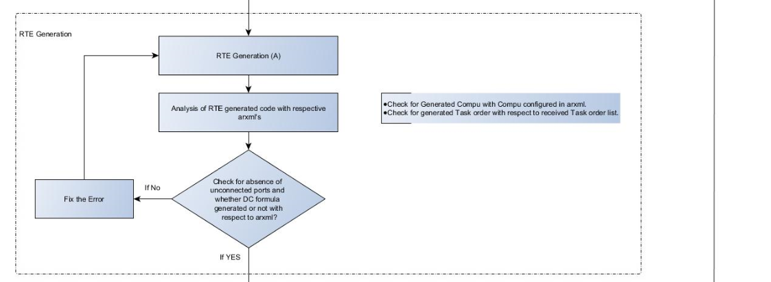
ASW-Integration Steps -5 macro details

Slide 19
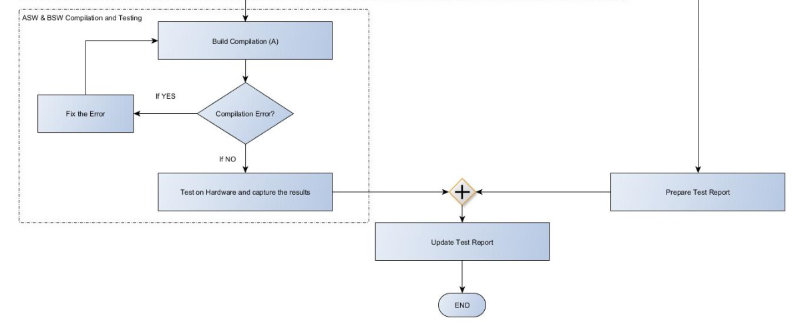
ASW-Integration Steps -6 & 7 macro details
(A) – Automatic execution

Slide 20
Sr.No | Activity | Subtask | Full new ASW integration | New ASW SWC addition | BSW Changes | Only 2 interface updates in existing ASW code | Only Source code Change
 | Integration |  |  | Change of Arxml |  | Change of Arxml | No change of Arxml
1 | Analysis and validation of ARXML | • System Desk project Validation • Check all ports are connected with assembly and delegation port. • Raster vs Arxml runnable time period • Check for unconnected port are i/p or o/p form Bsw. • RTE matrix preparation. • Task order analysis • CARASI analysis • Fault matrix analysis • DBC analysis for compu formula creation | 40 | 24 | 0 | 8 | 0
2 | Creation of Service component - DEM EcuM BswM DCM NvM CDD | • Creation of service ports to communicate with Application. | 40 | 0 | 16 | 0 | 0
3 | Integration of received Top level and KPIT service component and cdd arxml - | • Connecting ASW and BSW ports by creating assembly and delegation port | 16 | 8 | 0 | 8 | 0
4 | RTE Configuration | • ASW SWC Instance creation. • RTE bsw module instance creation. • Runnable mapping with OS task. • Bsw Module integration. • Miscellaneous activity(Native declaration for Base data type, mode port configuration) PIM configuration | 40 | 16 | 0 | 0 | 0
5 | Com Isignal mapping | • Compu creation for com Isignals Isignal mapping | 16 | 0 | 0 | 0 | 0
6 | RTE Generation | • RTE generation and Error resolution. Analysis of RTE generation code with respective arxml. • Check DC formula with arxml check List of unconnected port | 16 | 8 | 8 | 4 | 0
7 | ASW BSW code compilation | • Application Code analysis • Make file updating. • Resolve compilation error. | 24 | 4 | 4 | 4 | 4
8 | Code update for testing |  | 16 | 4 | 0 | 4 | 0
9 | Testing |  | 86.66666667 | 2.666666667 | 0 | 0.266666667 | 0
10 | Test Report update |  | 43.33333333 | 1.333333333 | 0 | 0.133333333 | 0
 | Total |  | 338 | 68 | 28 | 28.4 | 4
 | Time for Review, process, re-work |  | 33.8 | 6.8 | 2.8 | 2.84 | 0.4
 | Total |  | 371.8 | 74.8 | 30.8 | 31.24 | 4.4
 | Total in PD's | PD's | 46.475 | 9.35 | 3.85 | 3.905 | 0.55

Slide 21
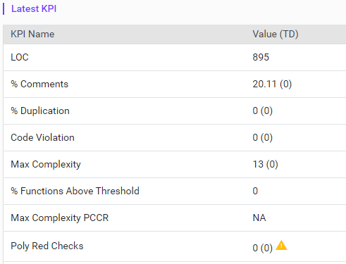
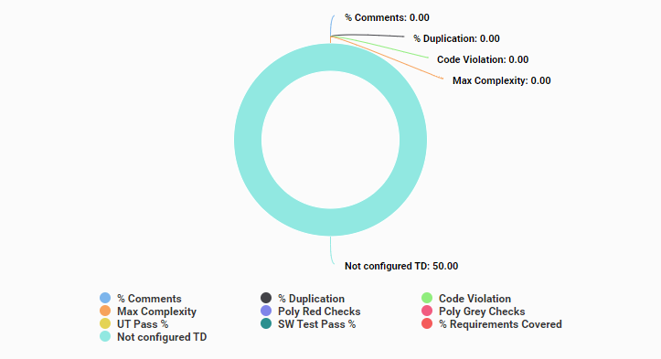
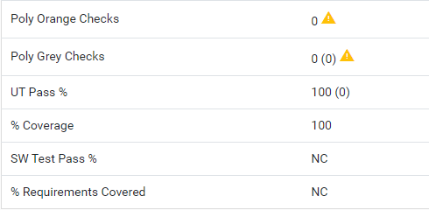
Katapult Dashboard /SBC
Technical Distribution /SBC
% Comments |  | % Duplication |  | Code Violation |  | Max Complexity |  | Max Complexity PCCR
Min | Max | Min | Max | Min | Max | Min | Max | Min | Max
20 | 50 | 0 | 5 | 0 | 0 | 0 | 20 | 0 | 20
Poly Red Checks |  | Poly Grey Checks |  | UT Pass % |  | % Coverage |  | SW Test Pass % |  | % Requirements Covered
Min | Max | Min | Max | Min | Max | Min | Max | Min | Max | Min | Max
- | 0 | - | 0 | 100 | - | 95 | - | 100 | - | 95 | -
%Coverage – MCDC Coverage
SW Test Pass % - SW Integration Testing percentage
% Requirements Covered – Requirements to Testing coverage based on traceability

Slide 22

Thank You

Slide 23
Delivery Process
MCAL Branch
RTE Branch
BSW Branch
Merged on Development
Execution of complete build process on development branch
Tag the build
Integration Testing
V&V Testing
Unit testing
Module review
Build check
Requirement coverage
SW Testing
Tessy testing
Test Bench
Tools
Polyspace
QAC
Review checklist
Coding guideline
Functional review
Polyspace
QAC
Test Bench
Tools
Test Bench
Tools
Test Bench
Tools

Slide 24
Merge Request
Merging (After successful Review)
ZF shared library
MCAL Branch
Unit Testing
Module Review
BSW Branch
Unit Testing
Module Review
Development branch
Integration verification
Integration Testing
VnV Testing
CDD Branch
Unit Testing
Module Review
RTE Branch
Unit Testing
Module Review
If any Test case fails or Delta Update from integration
Unit Testing Phase :- It includes Tessy testing (SIL), Polyspace, QAC
Module Review Phase :- Review checklist, Coding guideline, Functional review

